Slide 1
Front End Engineering
Project - 1
Dhruv Sood (2210990279)
Dhruv Shukla (2210990278)
Divanshu Garg (2210990289)
Khushdeep Sharma (2210990509)
Team Details:
Faculty Coordinator:
Parul Gehelot
Chitkara University Institute of Engineering and Technology,
Chitkara University, Punjab

Slide 2
Contents
Introduction
Problem Statement
Technical Details
Key Features
Project Highlights
Conclusion
References/Links used

Slide 3
Introduction
CRYPTO CURRENCY PORTFOLIO TRACKER
Made By:
Dhruv Sood (2210990279)
Dhruv Shukla (2210990278)
Divanshu Garg (2210990289)
Khushdeep Sharma (2210990509)

Slide 4
Problem Statement
Developing a cryptocurrency portfolio tracker integrating real-time data via APIs.
Creating a cryptocurrency portfolio tracker with real-time data fetched from APIs poses several challenges. Ensuring data accuracy, security, and user-friendly interface are key concerns. Additionally, managing portfolio features, optimizing performance, handling errors, and complying with regulations are critical. Scalability and providing comprehensive documentation and support further add complexity to the project. Addressing these issues effectively is crucial for delivering a successful crypto portfolio tracker

Slide 5
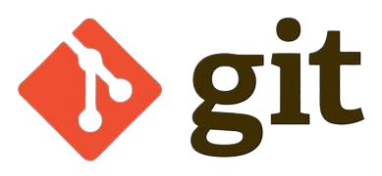
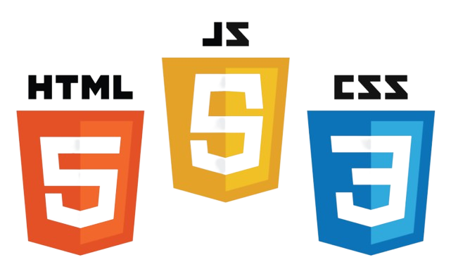
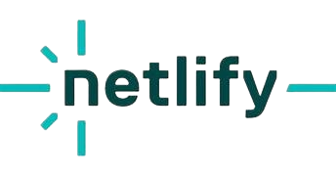

Technical Details
We employed HTML, CSS for crafting the user interface, and JavaScript for retrieving data from APIs.
Our choice of editor was Visual Studio Code, and we utilized Git and GitHub for collaborative work.
Netlify served as our hosting platform.
Ajax is an Asynchronous Javascript.

Slide 6
Key Features
1.Real-time Data Updates: Seamless integration with cryptocurrency exchange APIs to provide users with up-to-date information on prices, market trends, and portfolio values.
2. Performance Tracking: Tools to monitor portfolio performance over time, including metrics such as ROI (Return on Investment), profit/loss, and percentage change.
3. Price Alerts: Customizable price alert notifications to keep users informed about significant price movements for specific cryptocurrencies in their portfolio.
4.Multi-currency Support: Support for tracking portfolios denominated in various fiat currencies and cryptocurrencies, enabling users to manage diverse investment portfolios.
5.Charting and Visualization: Interactive charts and graphs to visualize portfolio composition, asset allocation, and historical performance trends.

Slide 7
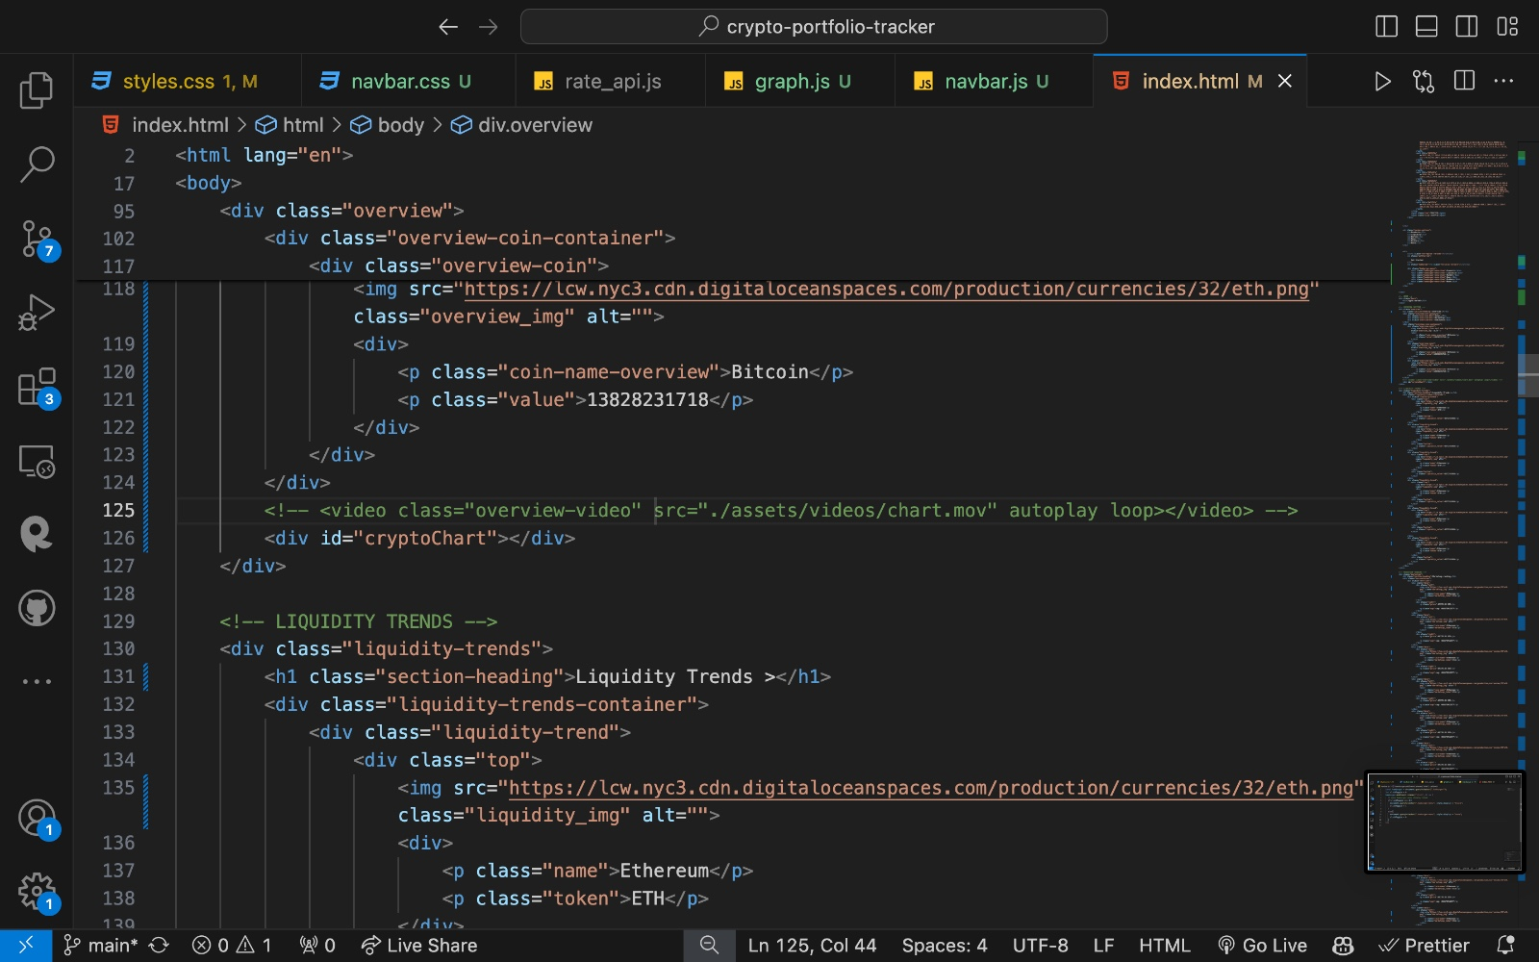
Project Highlights 1
HTML CODE SNIPPETS:

Slide 8
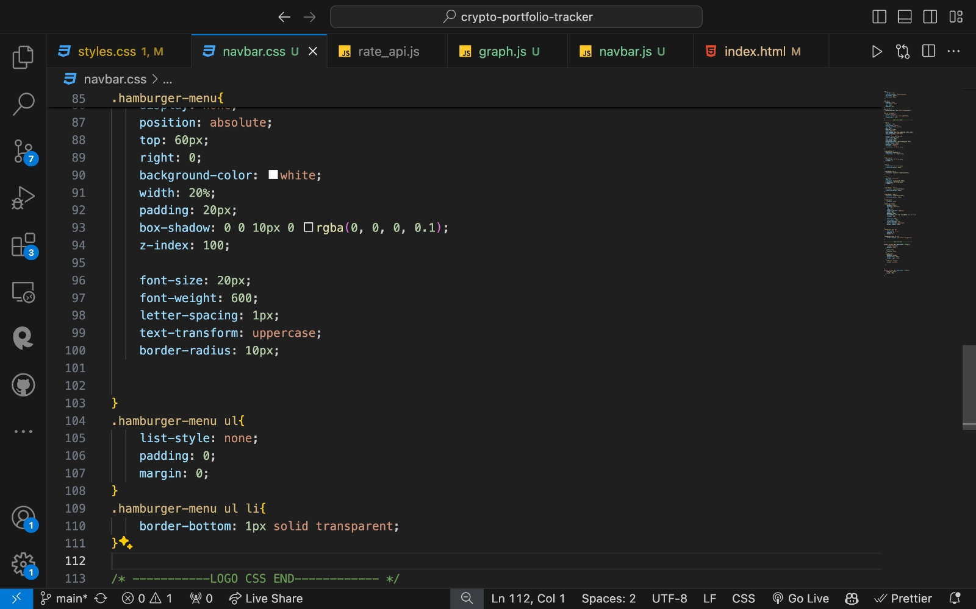
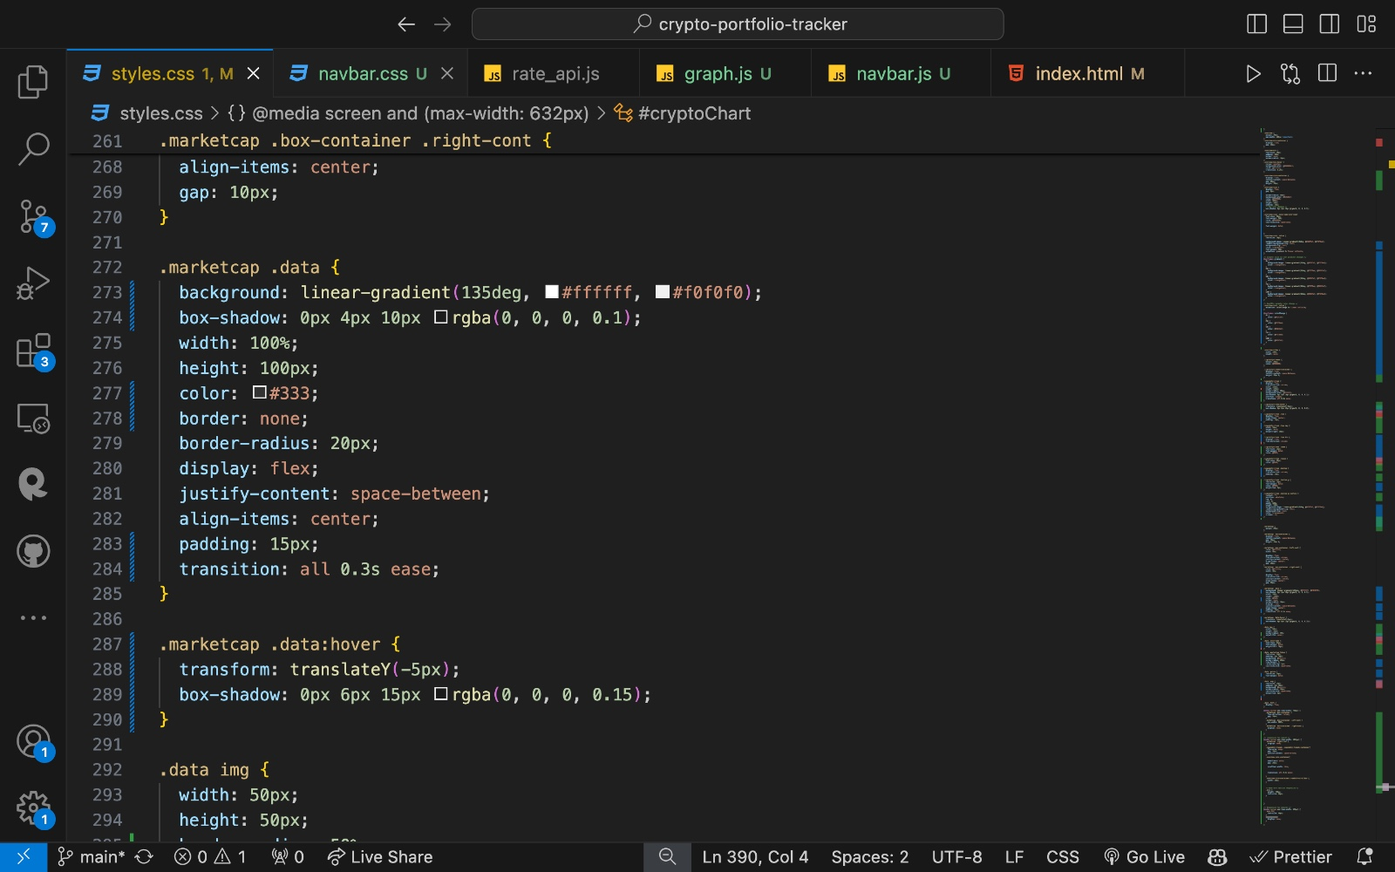
Project Highlights 2
CSS CODE SNIPPETS:

Slide 9
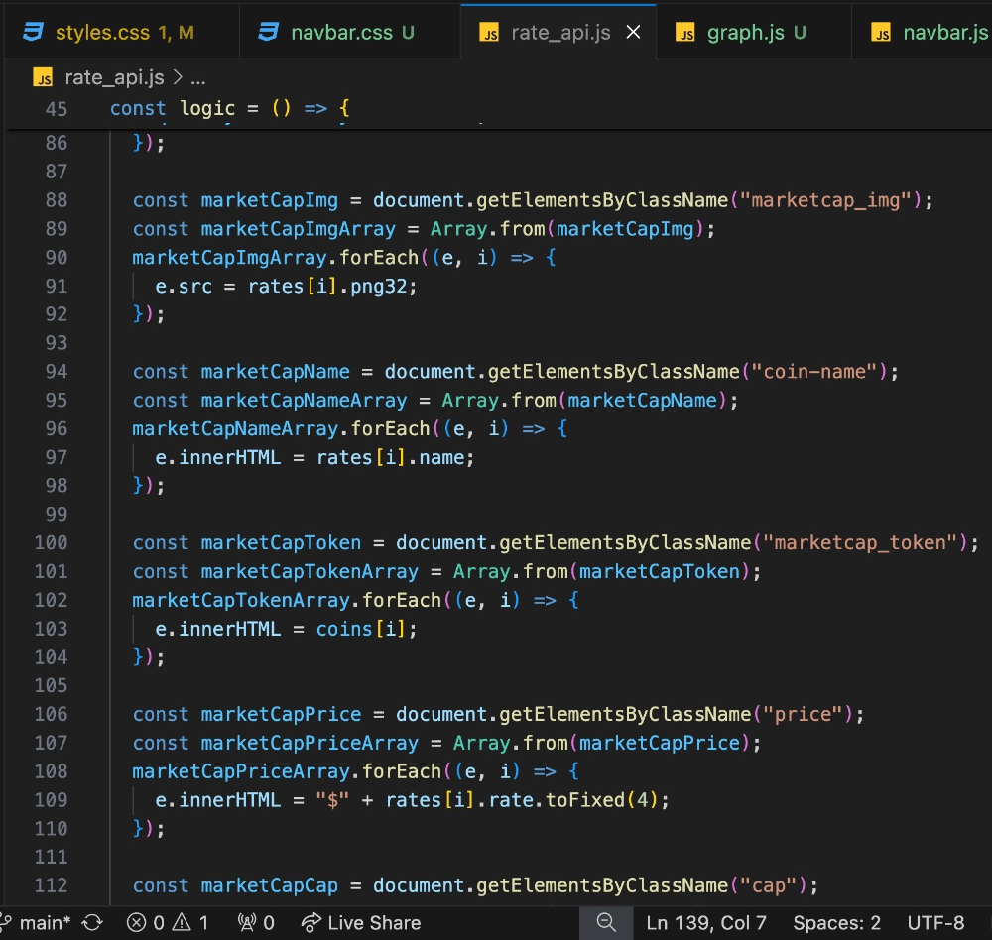
Project Highlights 3

Slide 10
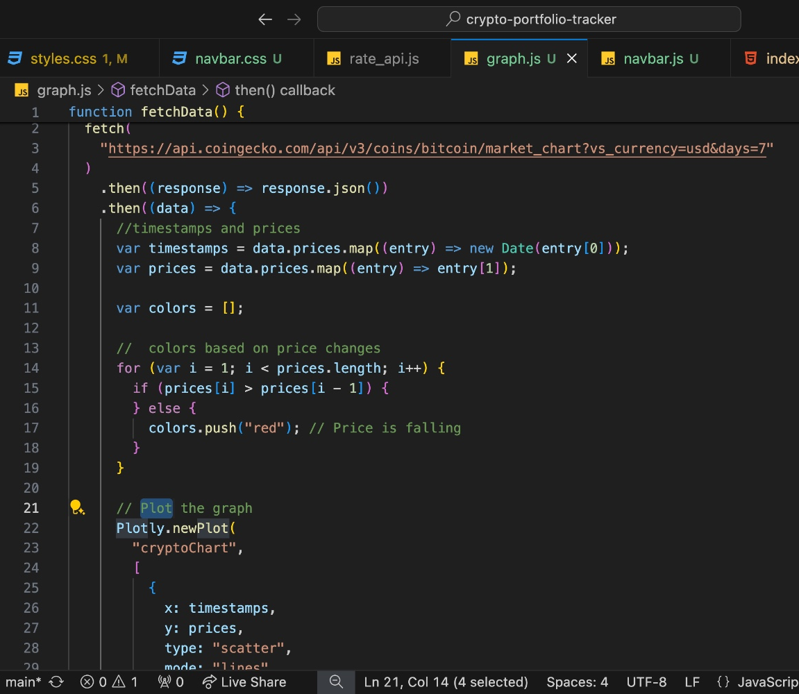
Project Highlights 1

Slide 11
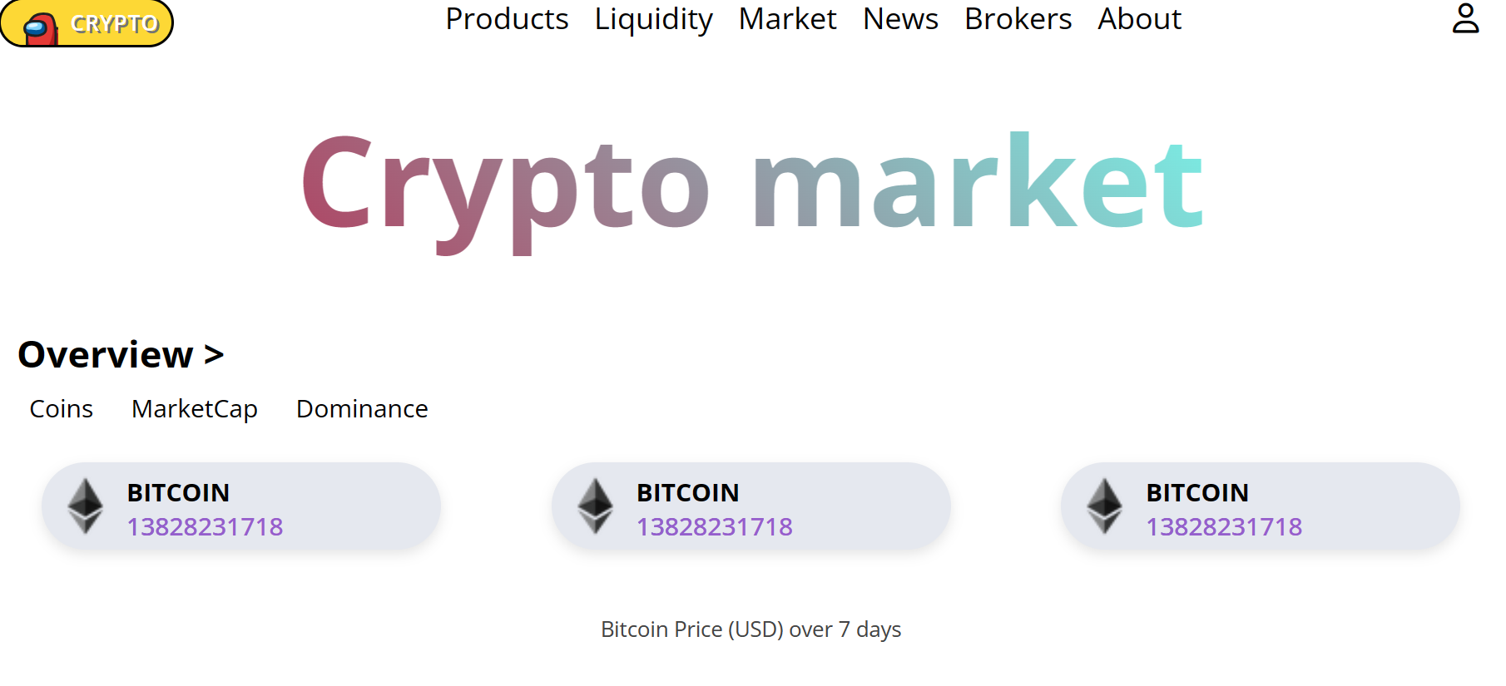
Conclusion

Slide 12
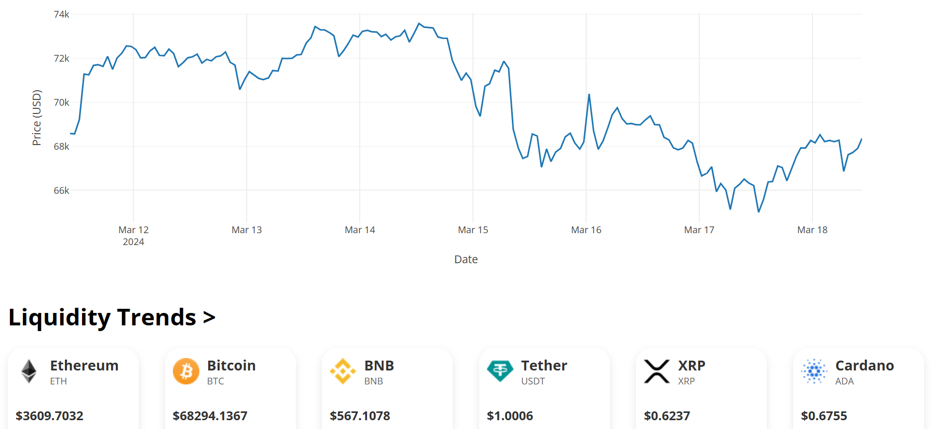
Conclusion

Slide 13
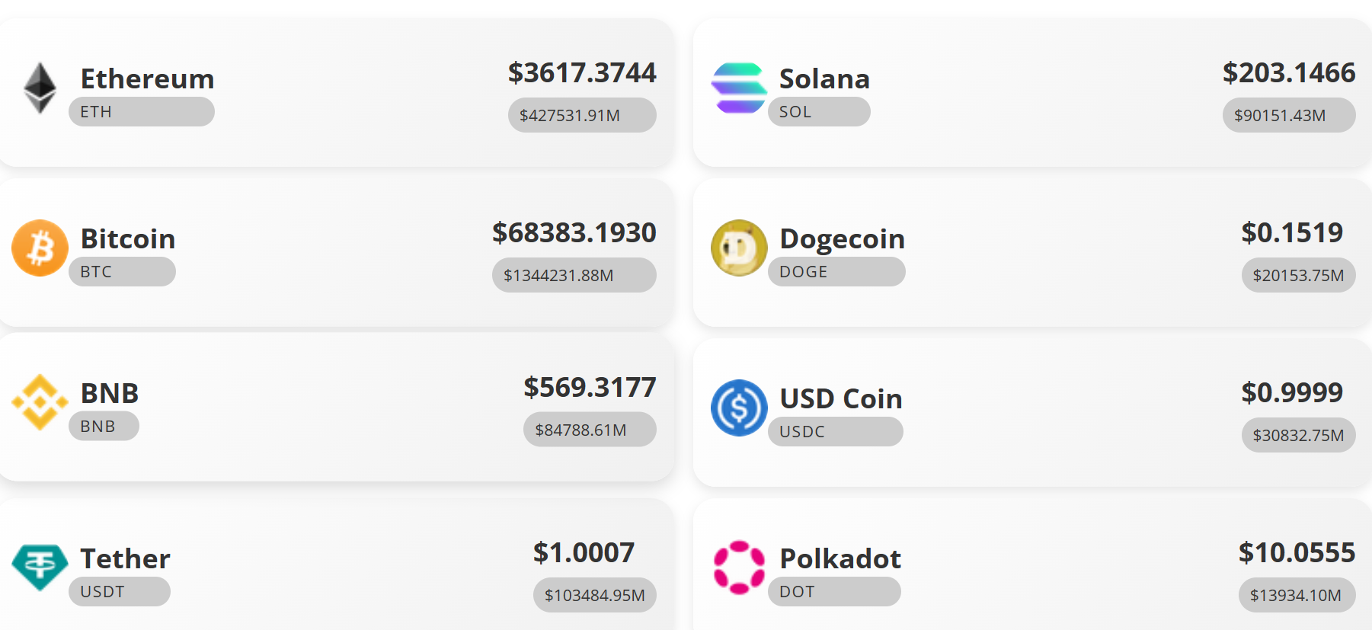

Slide 14
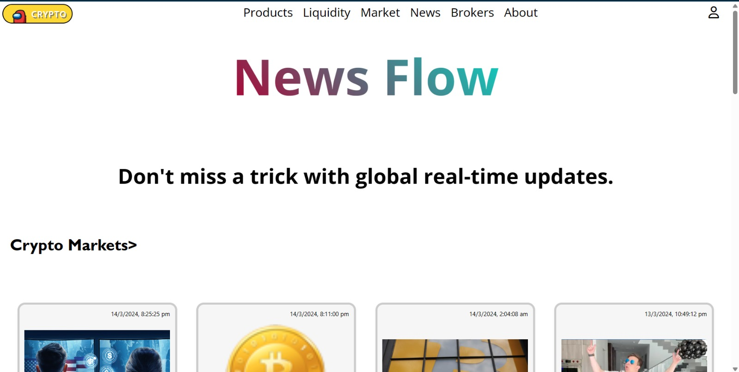

Slide 15
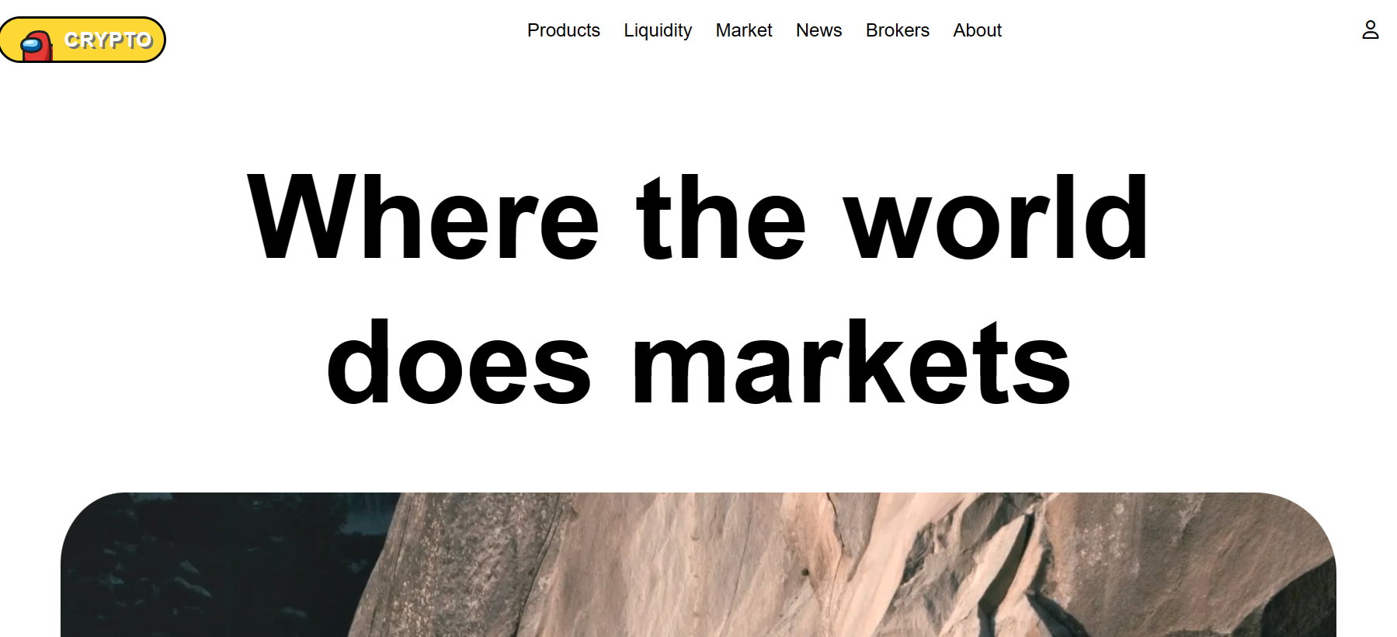

Slide 16
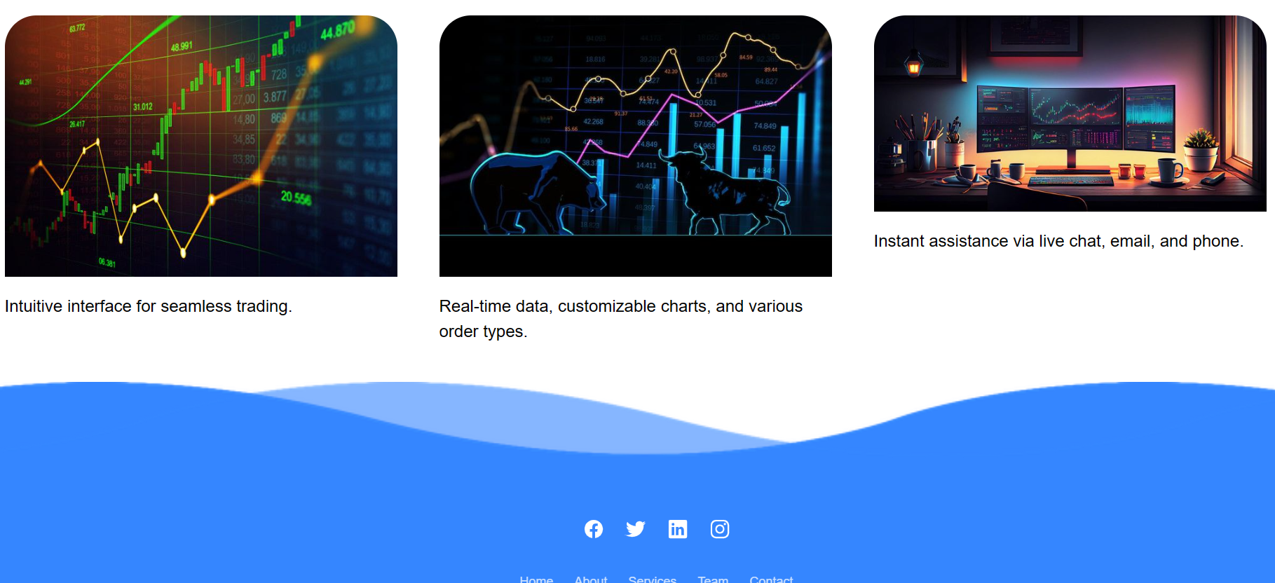

Slide 17
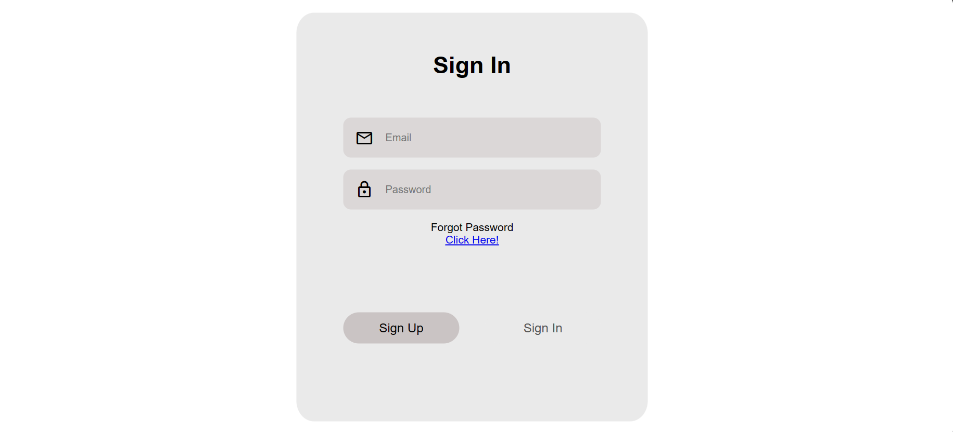

Slide 18
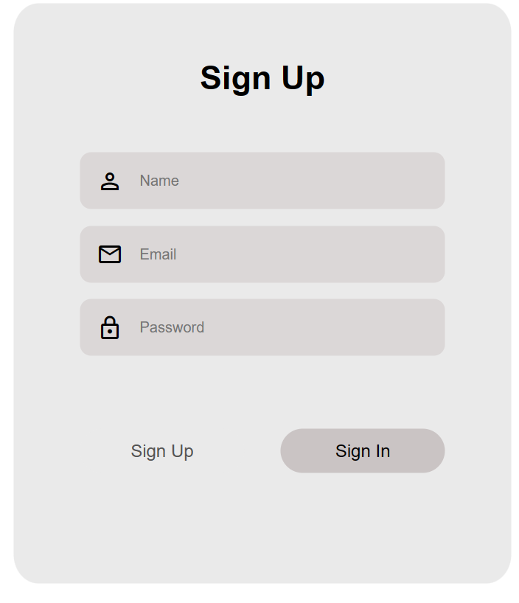

Slide 19
References/Links used
Web APIs (w3schools.com)
https://www.livecoinwatch.com
Font Awesome
Explore 3000+ Free UI Elements: CSS & Tailwind (uiverse.io)
https://www.coingecko.com/
https://newsapi.org/

Slide 20
Thank You

